Slide 1


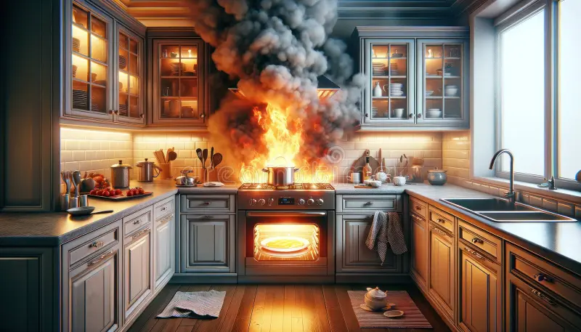
PROBLEM
•Kitchen = 49% of Home Fires
•Unattended cooking major cause
•Existing sensors =react (after fire).
•No Early prediction system
•Need : Prevent fire before ignition

Slide 2



SMART KITCHEN ACCIDENT PREVENTION SYSTEM AI-POWERED PROACTIVE FIRE PREVENTION
FIREZERO-AI
TEAM COFFEE & CODE:
R VIKRANT
MANISH CHIDAMBAR
C N SRIDEVI

Slide 3
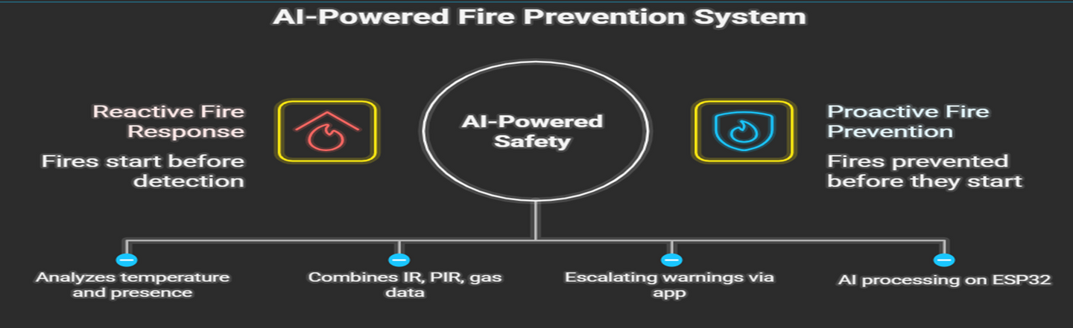
SOLUTION
REAL-TIME MONITORING OF TEMPERATURE, GAS LEVELS, AND HUMAN PRESENCE
EDGE AI ON ESP32 PREDICTS FIRE RISK EARLY
LIVE WEB DASHBOARD WITH CHARTS, ALERTS, AND RISK BADGES
SECURE LOGIN SYSTEM (USERNAME + PASSWORD) TO PREVENT UNAUTHORIZED ACCESS
OPTIONAL AUTO-SHUTOFF USING RELAY/SERVO TO PREVENT IGNITION

Slide 4
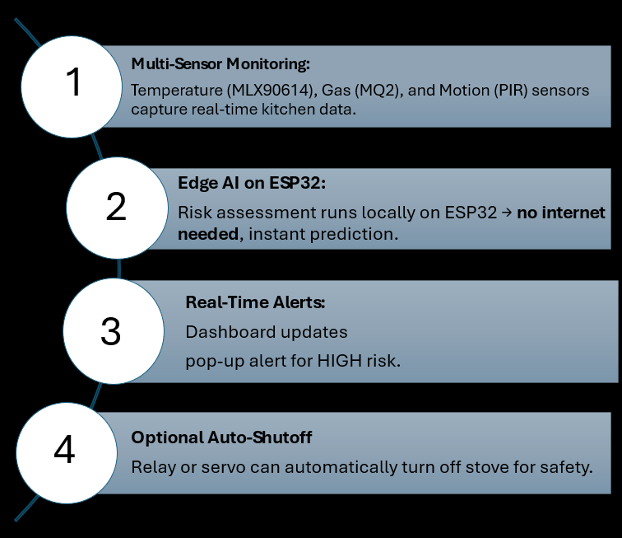
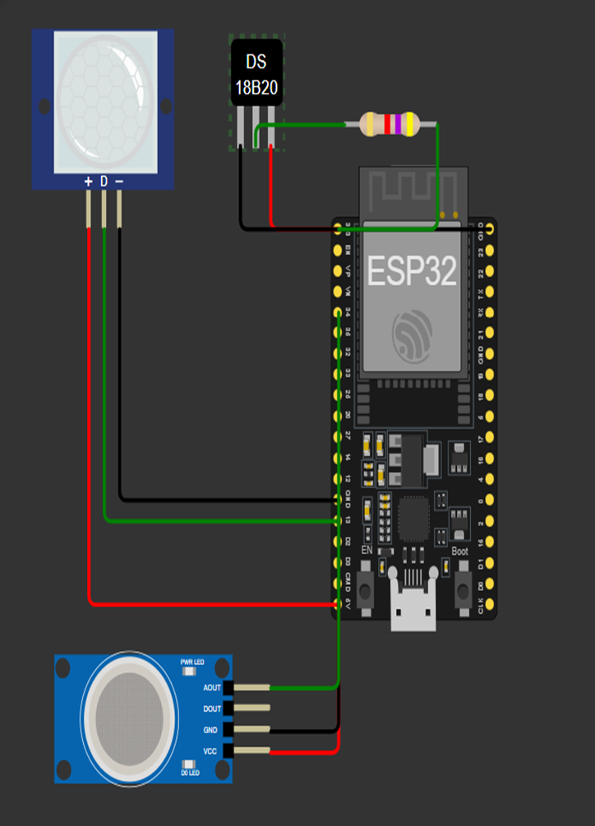
REAL-TIME FIRE RISK DETECTION

Slide 5
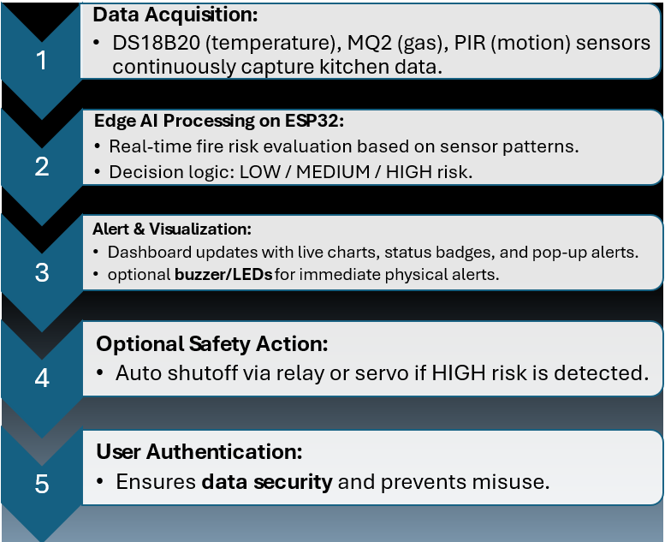
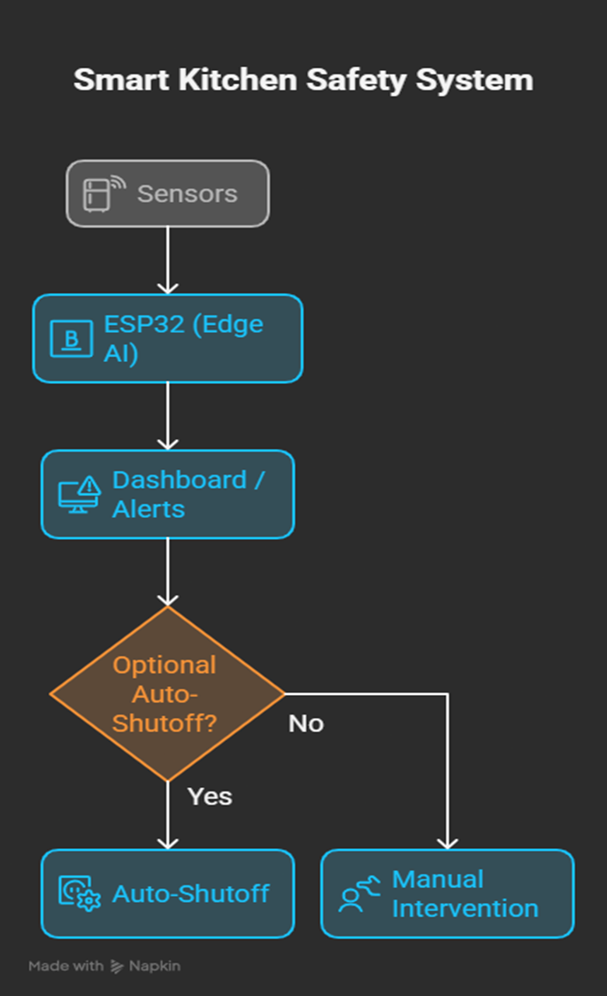
FIREZERO SYSTEM ARCHITECTURE

Slide 6
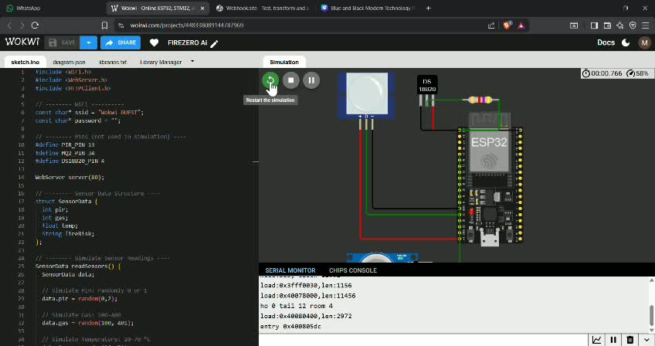
FIREZERO-AI IN ACTION

Slide 7

IMPACT & VALUE
EARLY DETECTION REDUCES PROPERTY DAMAGE AND INJURIES
PREVENTS 70–80% ACCIDENTAL KITCHEN FIRES
AFFORDABLE HARDWARE → ACCESSIBLE SOLUTION
INCREASES SAFETY FOR STUDENTS, ELDERLY, AND WORKING HOUSEHOLDS

Slide 8
WHY THIS SOLUTION IS FEASIBLE
USES LOW-COST, EASILY AVAILABLE SENSORS
ESP32 SUPPORTS BOTH WIFI + LOCAL PROCESSING
DASHBOARD BUILT WITH SIMPLE HTML + JS
FULLY ACHIEVABLE WITHIN AN 8–10 HOUR HACKATHON
NO CLOUD DEPENDENCY — WORKS OFFLINE

Slide 9
FUTURE SCOPE
MOBILE APP WITH PUSH NOTIFICATIONS
Machine learning model for predictive heat analytics
Integration with smart home assistants
Advanced gas type detection
Cloud dashboard for long-term data logging
SCALABILITY
DEPLOYABLE IN HOMES, HOSTELS, PGS, RESTAURANTS, CLOUD KITCHENS
One dashboard can monitor multiple kitchens
Modular hardware allows easy upgrade
Works even in rural areas due to offline capability
Manufacturable at scale for under ₹2000–₹3000 per unit (bulk cost)

Slide 10
THANK YOU

